Slide 1
Pothole Detection Robot using ROS and OpenCV/ Deep Learning
U17EC122 - Pankaj Kumar Vijayvergiya
U17EC151 - Prakash Saini
U17EC152 - Sarvesh Dubey
U17EC153 - Dhruvil Parikh
Guide Name: Prof A. H. Lalluwadia
Examiner Name: Dr J. N. Sarvaiya
Dr K. P. Upla
Dr Suman Deb
Dr Raghavendra Pal
Group Number: G05
Date: 12/05/2021
Time: 10AM to 1PM

Slide 2
OUTLINE
Need
Mechanical Design
Modelling and Simulation
Detection Using Deep Learning
Results
Questions

Slide 3
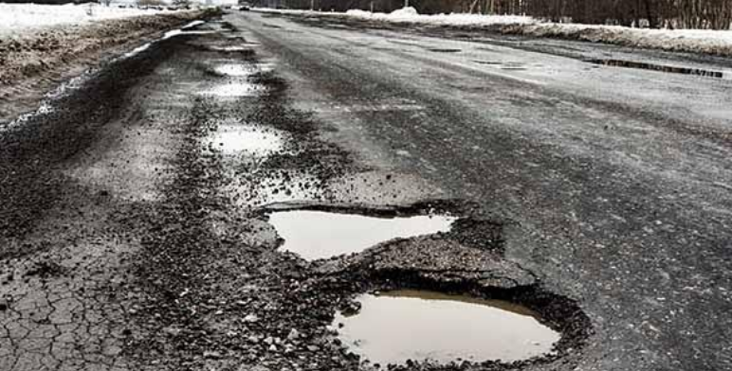
Need of Pothole Detection Robot
Pothole is a type of disruption/disturbance in the surface of roadway where a portion of the road material has broken away, leaving a hole.
Mostly potholes are formed due to fatigue of the road surface, insufficient pavement thickness, heavy rainfall, etc.
Every year crores and crores of rupees are spent by the highway agencies in extensive pothole patch repairs.
Fig.1.1: Potholes [5]

Slide 4
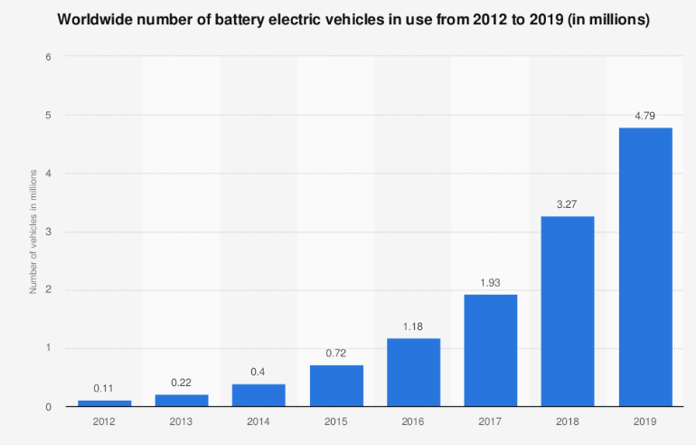
Need of Pothole Detection Robot
The number of vehicles drastically increases every year, and the number of accidents proportionally does too.
In India, 3,000 people per year are killed in accidents involving potholes. Britain has estimated that the cost of fixing all roads with potholes in the country would cost 12 billion.
Fig.1.2: Number of vehicles vs Usage of the vehicle [10]

Slide 5
Literature Survey
Pothole Detection and Surveys are being done by :-
Modern Methods
TF Object Detection API
Transfer learning
FRCNN Based Algorithm
Traditional Methods
Public Reporting
Vibration Based Methods
2D-Vision Based Methods
3D-Scene Reconstruction Based Model
Learning-Based Methods

Slide 6
Technologies used
in this project
Robotics
Deep learning For potholes Detection
Robotics :-
ROS ( Robot Operating System)
Gazebo
Deep Learning :-
ResNet
OpenCV
TensorFlow

Slide 7
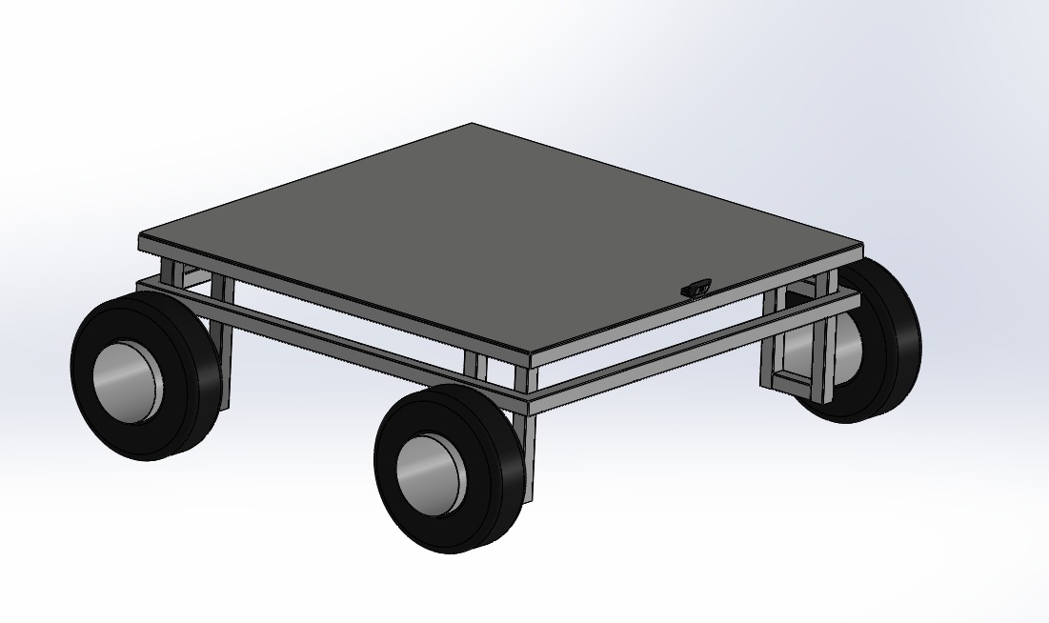
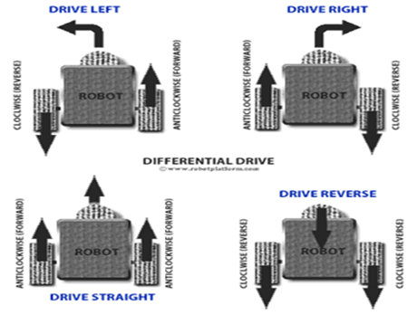
Mechanical Design
Differential Drive System
Ackermann Steering
Four Wheeled Omni Robot
Figure 3.1: CAD (Solidworks Model)
Fig 3.4: Differential Drive System [57]

Slide 8
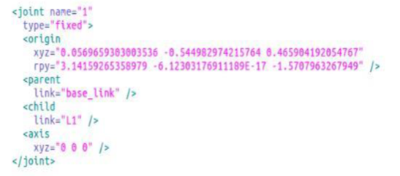
Fig.3.2: Sample URDF model [59]

Slide 9
Modelling and Simulation
Modelling & simulation are the major parts of scientific and engineering processes, especially in industries wherein heavy amount of resource might get wasted due to faulty systems.
They play an important role in the performance analysis and in the development of advanced control algorithms for robotic systems.
Simulation can be used as a tool to develop virtual environments for training operators as well as an educational tool for teaching and learning the basic concepts of robotic systems.
Simulation provides low cost means of testing and experimentation, and makes controlling disturbances much easier compared with using real robotic systems.

Slide 10
Gazebo & ROS
Gazebo is a multi-robot simulation tool which has the capability of accurate and efficient simulation of a population of robots, sensors and objects in a 3-dimensional world.
Gazebo generates realistic sensor feedback and has a robust physics engine to generate interactions between objects, robots and environment through URDF scripts.
Gazebo is offered freely as a stand-alone software, but has also been packaged along with Robot Operating System (ROS) as the simulation tool.
ROS is an open source robotic middleware that provides libraries and tools to help software developers produce robot programs. It provides hardware abstraction, device drivers, libraries, visualizers, message-passing system, package management, and more user-friendly interfaces.

Slide 11
Simulation Environment
The Gazebo simulator has provided dynamics simulation by considering gravity, friction, and contact forces provided by the included physics engines Open Dynamics Engine – ODE.
Different types of Gazebo plugins have been enabled to develop control interfaces and sensing systems for pothole detection bot. Further sections are divided as:
World environment model description
Physical model description
ROS/GAZEBO plugins to model the sensors and control/hardware interfaces.
Fig. 4.1 on the next slide shows the general structure and the required components in Gazebo to model a robotic system.

Slide 12
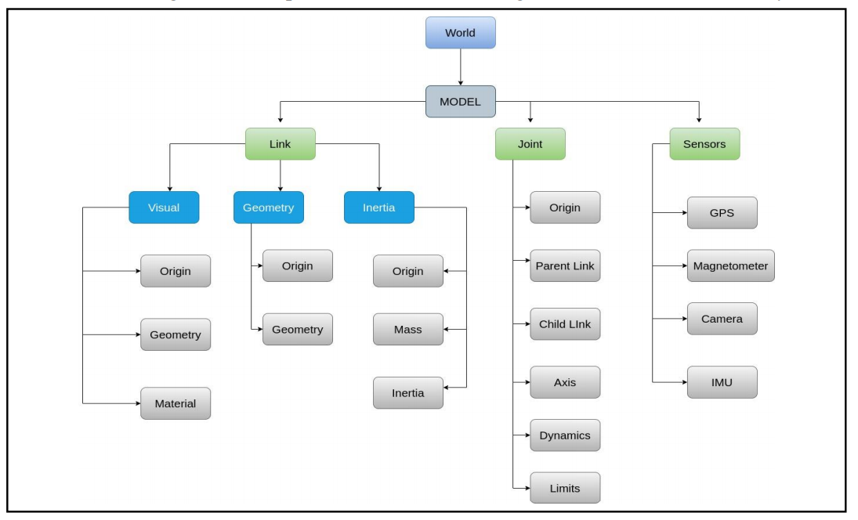
Simulation Environment
Fig.4.1: General structure and the required components in Gazebo to model a robotic system [25]

Slide 13
Physical Model Description
A robot, as a dynamic object in the world, consists of links that are connected to each other by joints.
A link in Gazebo describes the kinematic and dynamic properties of a physical link in the form of visual/collision geometry and inertia information.
A joint models kinematic and dynamic properties of a joint such as joint type, motion axes, and joint safety limits.
All this information is described in the Universal Robotic Description Format - URDF file format so that we can frame design constraints.
To model pothole detection bot, 10 links and 9 joints need to be defined as described earlier.
The base_link describes the chassis and four links are connected to it by four fixed joints as driving links. Each of the driving links are connected to a wheel by a continuous joint through motor. Each sensor also should be defined as a physical link attached with a fixed type joint to the base_link.

Slide 14
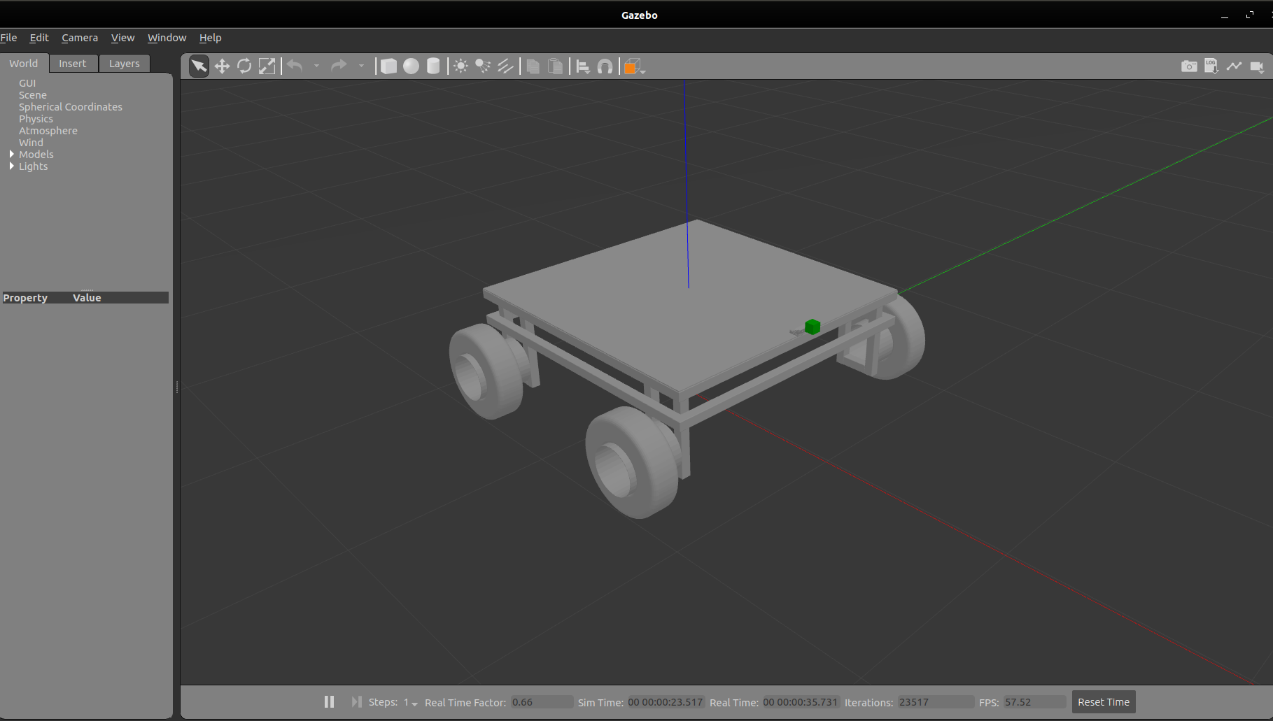
Physical Model Description
Fig.4.3: Pothole Detection Bot in Gazebo

Slide 15
World Description
World is a general term to describe objects, global parameters and physics properties. By default, a world is defined by Gazebo with default required parameters.
The objects in the world can be static or dynamic. Static objects such as building, lights or walls are defined by their visual and collision geometry. Dynamic objects such as robots are defined not only by visual and collision geometry but also by their inertia information.
Objects can be created using standard geometric shapes, or inserted from the model database, or created and by any 3D modelling tools and imported to the Gazebo simulator environment.
Scripts can also be added in sdf format for advance modelling.
Fig. 4.2 shows a simulated environment in Gazebo with the set physics parameters such as gravity. These objects were created using the sdf scripts and models were integrated from GAZEBO library.

Slide 16
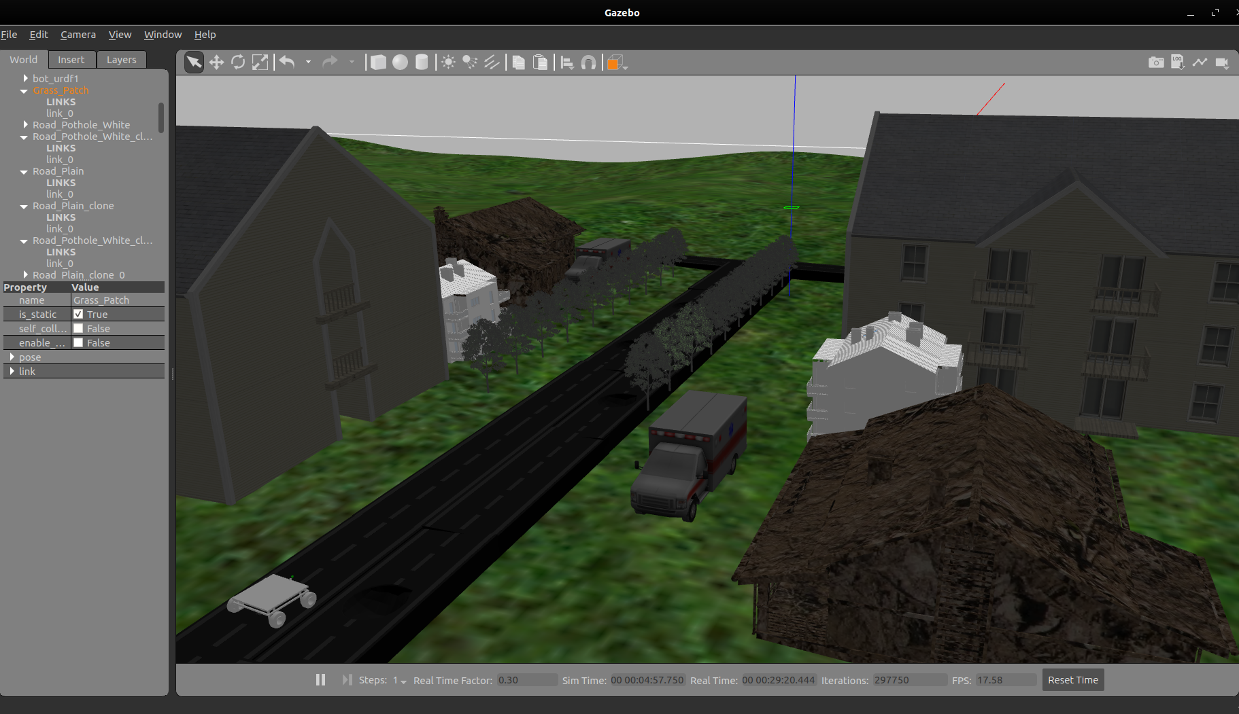
World Description
Fig.4.2: A simulated environment in Gazebo

Slide 17
Vision Camera
Vision camera is a vision system to simulate the real physical world.
Camera gives the ability to generate images.
Typically, a camera that is placed at the center of robot to capture images of field.
Through several pre-processing steps, images are being converted into video and DL model has been implemented to classify between pothole and plain road.
All the required parameters such as frame rate, image width and height, output format, base line distance and noise parameters can be defined within Gazebo plugin through URDF.
Fig. 4.4 shows the visualization of simulated camera by showing the image of an environment in Gazebo.
Parameters for plugin has adopted from hector project to model the simulated camera.

Slide 18
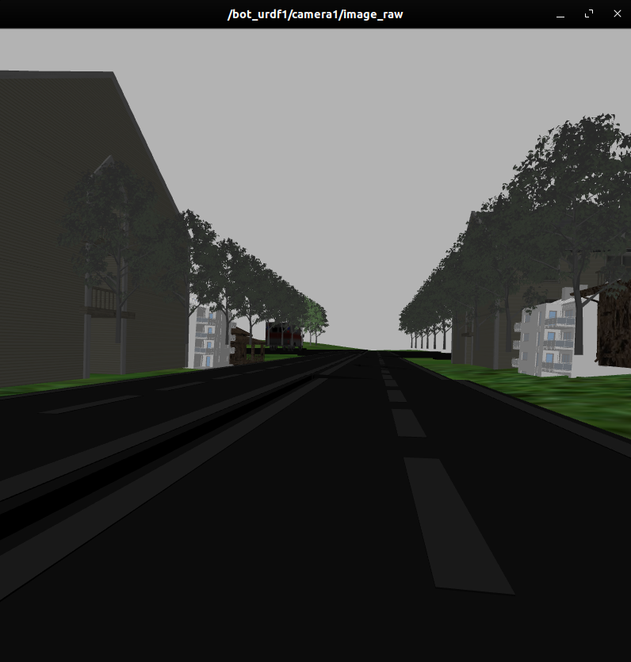
Vision Camera
Fig.4.4: Visualization of simulated camera by showing the image of an environment in Gazebo

Slide 19
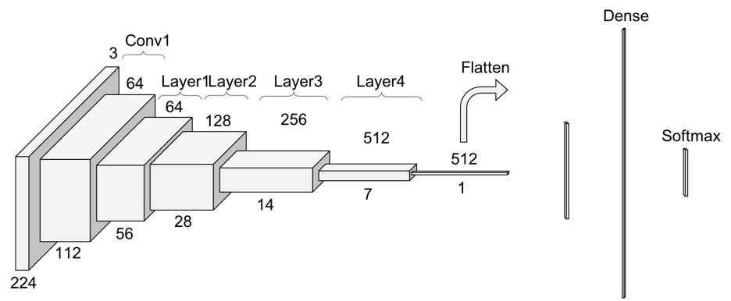
Deep Learning Approach
ResNet 34
A residual neural network (ResNet) is an artificial neural network (ANN) of a kind that builds on constructs known from pyramidal cells in the cerebral cortex. Residual neural networks do this by utilizing skip connections, or shortcuts to jump over some layers.
Fig.5.3: Another look at ResNet 34 [40]

Slide 20
Deep Learning Approach
ResNet 34, 50, 101
Proposed Approach
In the previous approach, we tried the InceptionV3 model with some changes to the last layers and addition of some layers to the model. This time we tried something different from our previous approach trying out ResNet34, ResNet50 and ResNet101 with some tweaks in the last layers of the model. Before moving to stats or results obtained after applying our custom model to the problem, let's first dive more into the model structure of ResNet and discover some key features that set it out from other types of architectures.
ResNet helps the model to improve the accuracy by the residual network. The residual network helps with the pseudo memory from the skipped layer as well as the previous to previous layer.

Slide 21
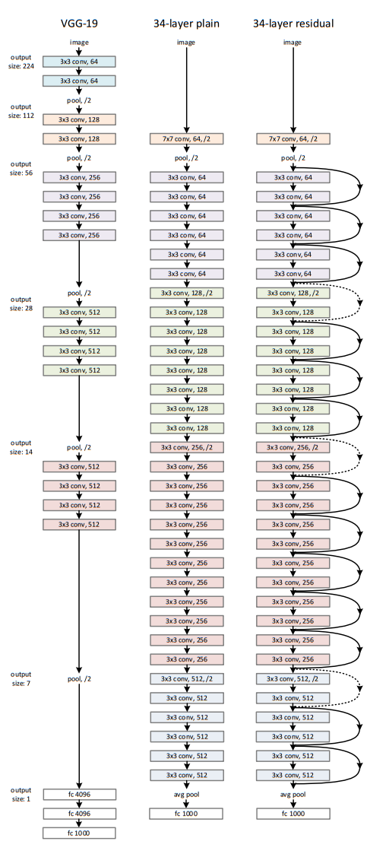
Deep Learning Approach
(Transfer
Learning)
VGG vs ResNet 34
Fig.5.2 Comparison of ResNet (plain and residual) vs VGG [33]

Slide 22
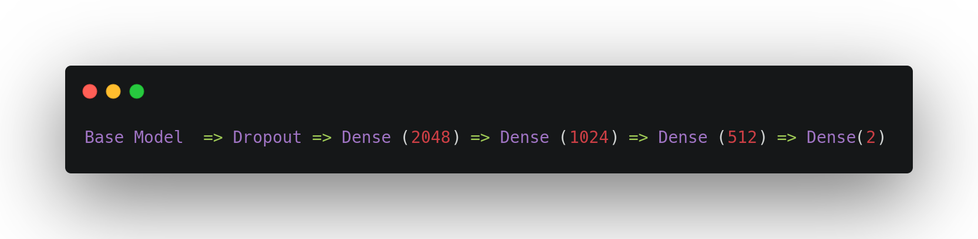
Proposed Methods for Training ResNet as Base Model and Custom Layers at the end of the Model
We have tweaked the model using the base model as ResNet and adding some layers at the end to enhance the accuracy of the model. So the final model looks like:-
Adding this tweak at the end of the layer we increased the final validation accuracy from 89% to 96%.

Slide 23
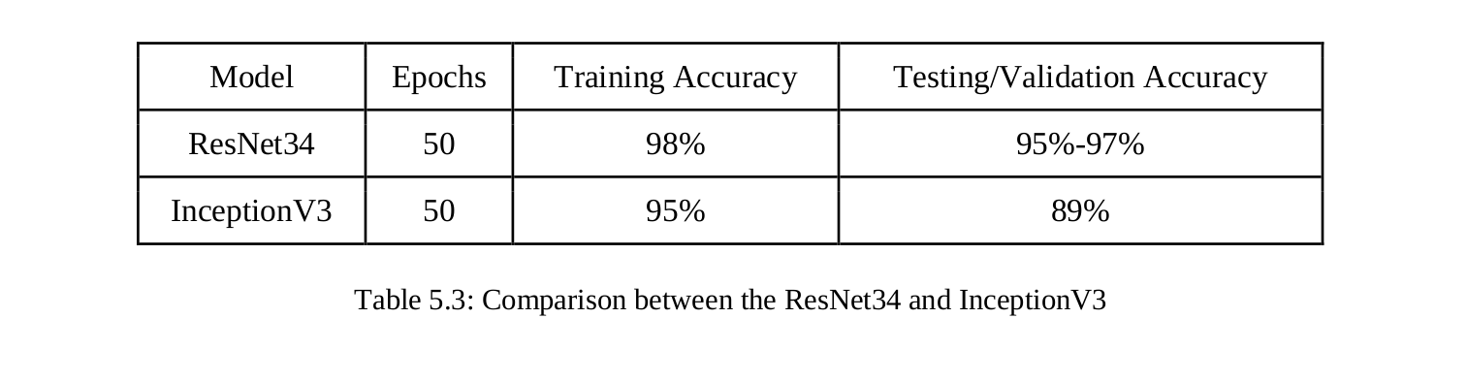
Comparison

Slide 24
Results

Slide 25
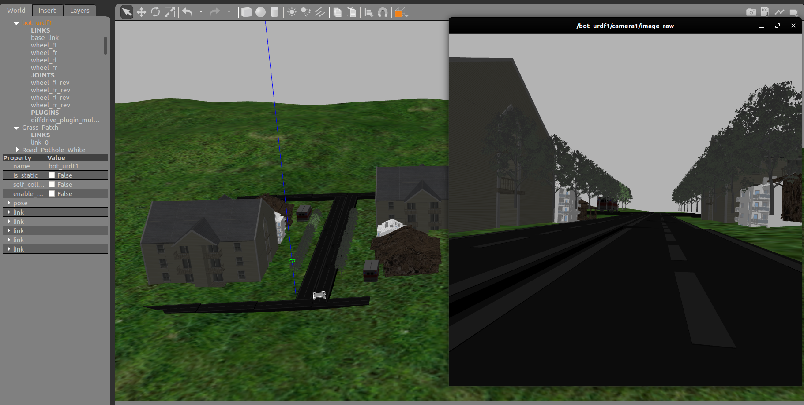
Teleoperation
Fig.6.1: Road Traversing through Teleoperation

Slide 26
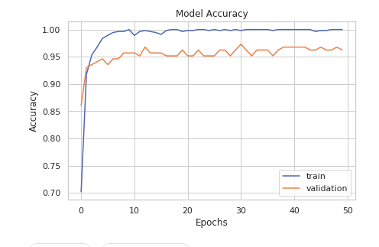
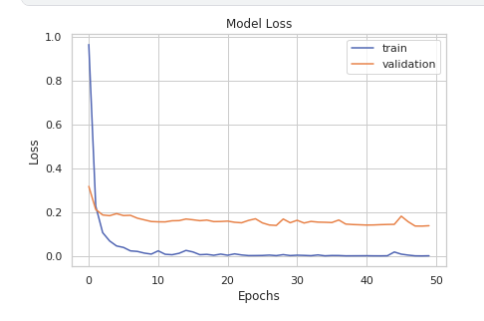
Model Accuracy & Loss
Fig.6.2: Model Accuracy
Fig.6.3: Model Loss

Slide 27
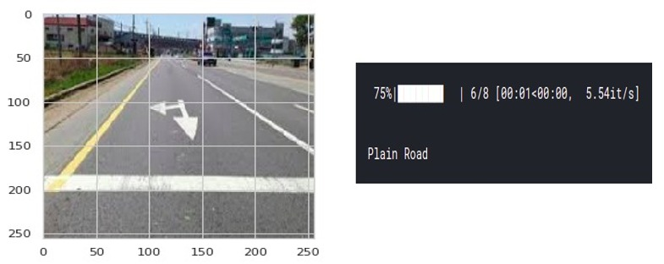
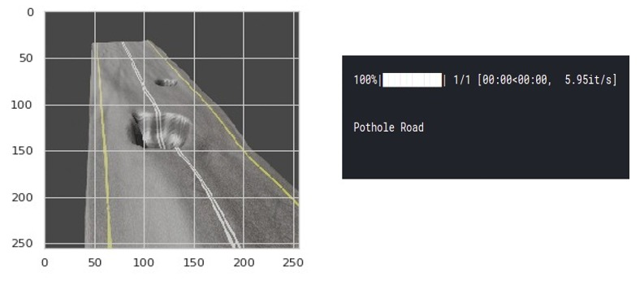
Prediction

Slide 28
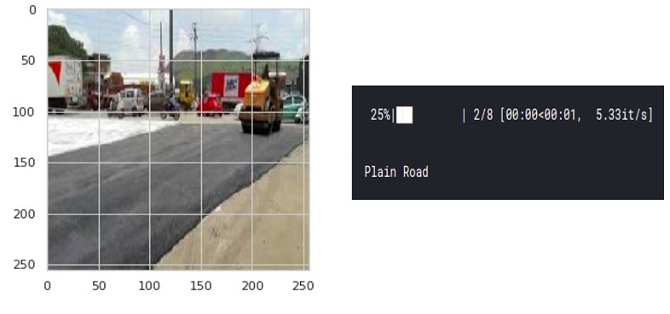
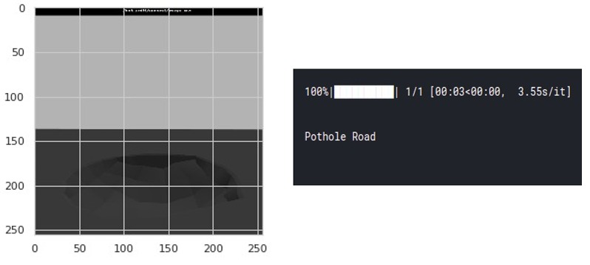

Slide 29
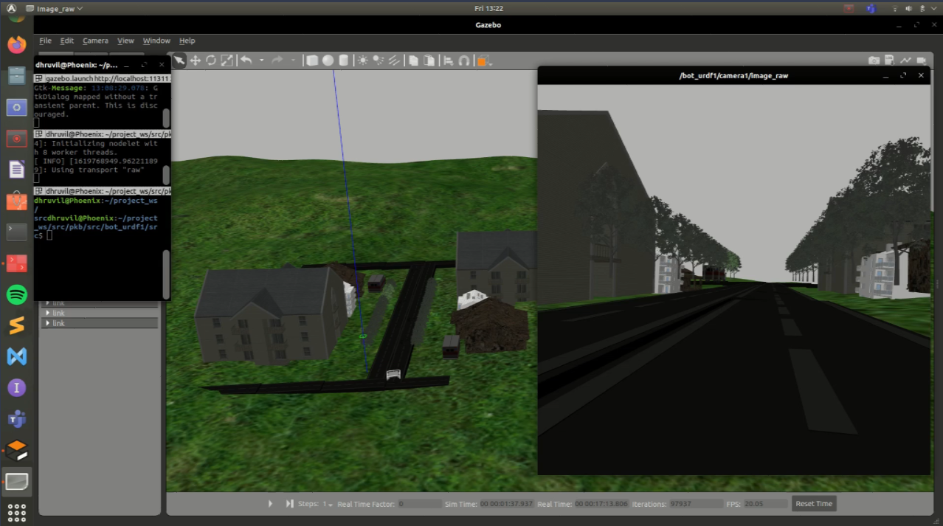
Demonstration

Slide 30
Future Works
Exploring different model architectures to provide better results like densenet 121.
To make the robot fully autonomous reducing considerably, the amount of human intervention.
Setting up a communication system with relevant government agency to provide them with data.

Slide 31
REFERENCES
[5] L. Vogel, C. J. Bester : A Relationship between accident types and causes. (1999)
[10] A. Tedeschi and F. Benedetto, “A real-time automatic pavement crack and pothole recognition system for mobile Android-based devices,” Adv.Eng. Inform., vol. 32, pp. 11–25, Apr. 2017.
[25] Mostafa Sharifi, XiaoQi Chen, Christopher Pretty, Don Clucas, Erwan Carbon-Lunel presented “Modelling and simulation of a non-holonomic omnidirectional mobile robot for offline programming and system performance analysis” in Simulation Modelling Practice and Theory 87 (2018) 155-169 by ELSEVIER.
[33] Kaiming He, Xiangyu Zhang, Shaoqing Ren, Jian Sun, “Deep Residual Learning for Image Recognition”.
[40] K. He, X. Zhang, S. Ren, and J. Sun. Spatial pyramid pooling in deep convolutional networks for visual recognition. In ECCV, 2014.
[57] Robot Platform, http://www.robotplatform.com/knowledge/Classification_of_Robots/wheel_control
_theory.html
[59] M. Quigley, K. Conley, B. Gerkey, J. FAust, T. Foote, J. Leibs, E. Berger, R. Wheeler, A. Mg, "ROS: an open-source Robot Operating System", ICRA Workshop on Open-Source Software, vol. 3, pp. 5, 2009.

Slide 32
Questions?

